Slide 1
Self Organized Criticality

Slide 2

Criticality
A state in a system where small changes results in significant and nonlinear effects.
These responses can have any size.
Key point: Sensitivity to small changes
Example: a ball on a hill

Slide 3
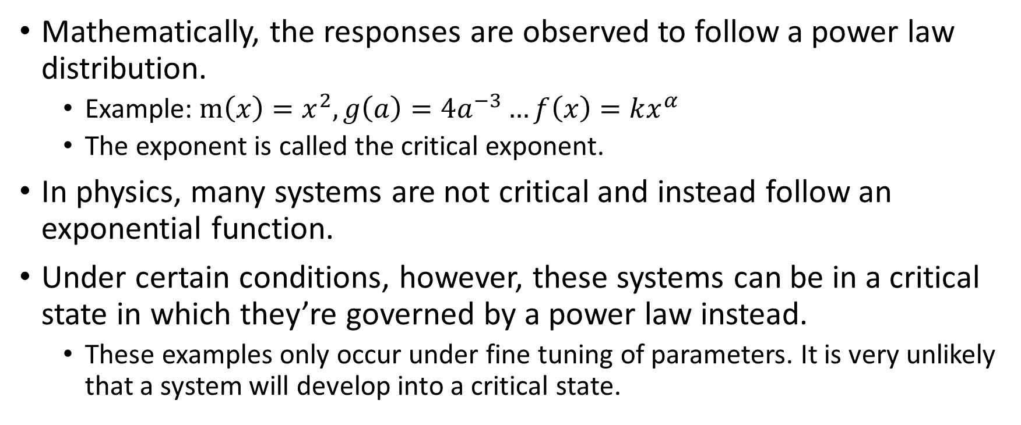
Criticality continued
Mathematically, the responses are observed to follow a power law distribution.
Example: $m\left(x\right)=x^{2}, g\left(a\right)={4a}^{−3}…f\left(x\right)=kx^{α}$
The exponent is called the critical exponent.
In physics, many systems are not critical and instead follow an exponential function.
Under certain conditions, however, these systems can be in a critical state in which they’re governed by a power law instead.
These examples only occur under fine tuning of parameters. It is very unlikely that a system will develop into a critical state.

Slide 4
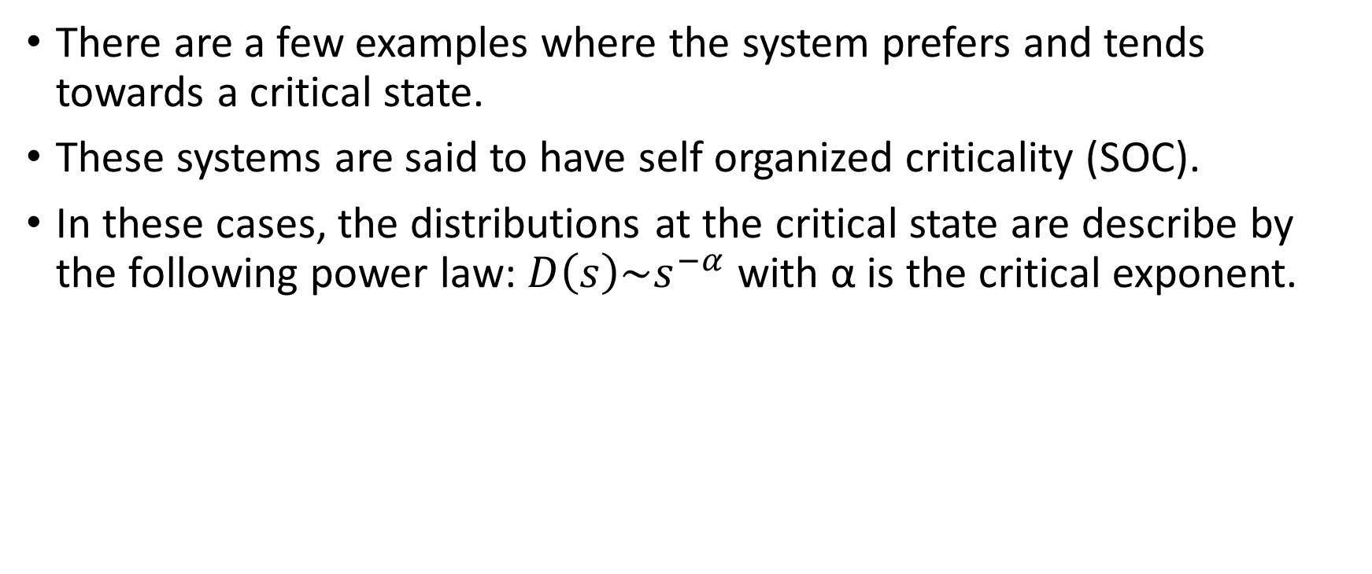
Organized Self Criticality
There are a few examples where the system prefers and tends towards a critical state.
These systems are said to have self organized criticality (SOC).
In these cases, the distributions at the critical state are describe by the following power law: $D\left(s\right)\sim s^{−α}$ with α is the critical exponent.

Slide 5
Abelian sandpile model
In my project, I played with a toy model of a sandpile
The rules go as followed:
Choose a random square on a finite square grid. Increment the amount of sand Z(x, y) on the square by one unit, Z(x, y) → Z(x, y) + 1.
If Z(x, y) = 4, topple the square. Set Z(x, y) → 0 and redistribute the four grains, one grain at each of the nearest neighbor sites. In the process, some of the neighbors might reach four grains. Apply this toppling rule to each site on the grid repeatedly until it is finished (no squares have four grains).
If toppling occurs on the boundary, remove from the simulation any sand that would be redistributed off the edge.
Repeat from the top, adding another grain of sand to a random point.

Slide 6
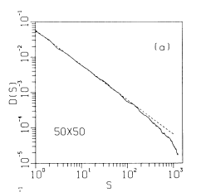
Sandpile model continued
The goal was to show that the distribution of avalanche follows the inverse power law and that the critical exponent α≈1
Size (S) vs Distribution (D(s))
Bak 1987

Slide 7
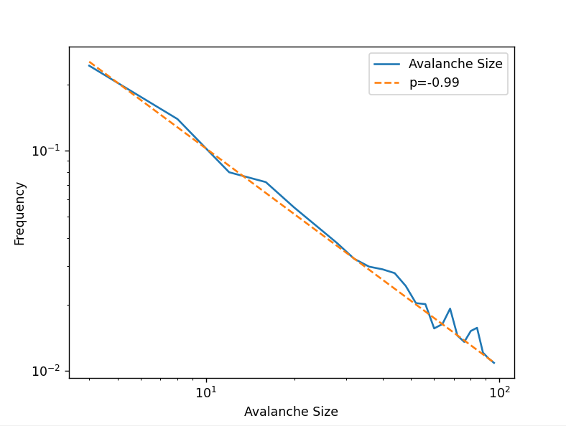
Results

Slide 8
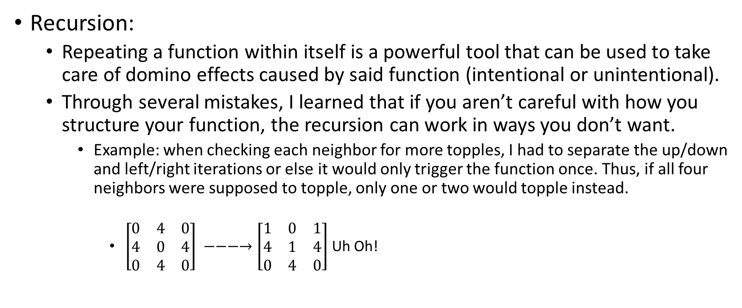
What I learned
Recursion:
Repeating a function within itself is a powerful tool that can be used to take care of domino effects caused by said function (intentional or unintentional).
Through several mistakes, I learned that if you aren’t careful with how you structure your function, the recursion can work in ways you don’t want.
Example: when checking each neighbor for more topples, I had to separate the up/down and left/right iterations or else it would only trigger the function once. Thus, if all four neighbors were supposed to topple, only one or two would topple instead.
$\left[\begin{matrix}0 & 4 & 0 \\ 4 & 0 & 4 \\ 0 & 4 & 0\end{matrix}\right] −−−→\left[\begin{matrix}1 & 0 & 1 \\ 4 & 1 & 4 \\ 0 & 4 & 0\end{matrix}\right]$ Uh Oh!

Slide 9
What I practiced
Fitting!
I used the Levenberg-Marquardt method to get the critical exponent. Although I could’ve used the lmfit package, I decided to create the algorithm on my own. (turned out to be a piece of cake!)
Code debugging:
You know the drill: programming = lots of table flipping as your code breaks for the millionth time.
There is not a “one size fits all” method to counter this. You need to have a toolkit of different ways of hacking at it depending on the context.

